Slide 1

Unlocking the
Precision of Aptamers
TO PIONEER THE FUTURE OF GLOBAL HEALTH
Triera Biosciences (Triera) is a Canadian biosciences company that is developing an aptamer therapeutics platform in partnership with McMaster University that seeks to accelerate innovation in the biomanufacturing and life sciences industry worldwide. ​
Triera is owned by Zentek Ltd., a publicly traded nanotechnology development and commercialization company based out of Canada.​

Slide 2
Forward-Looking Statement & Disclaimer​
This presentation is being provided for information purposes only and does not constitute or form part of, and should not be construed as, an offer or invitation to sell or any solicitation of any offer to purchase or subscribe for any securities of Triera Biosciences Ltd. (“Triera” or the “Company”) or Zentek Ltd. (“Zentek”) in Canada, the United States or any other jurisdiction. Trading in the securities of the Company should be construed as highly speculative. This presentation is not, and in no circumstances is it to be construed as, a prospectus, an offering memorandum, an advertisement, or a public offering of securities. No securities regulatory authority or similar authority has reviewed or in any way passed upon the document or the merits of any securities of the Company and any representation to the contrary is an offence. Except as otherwise stated, information included in this presentation is given as of the date hereof. The delivery of this presentation shall not imply that the information herein is correct as of any date after the date hereof. Readers should not construe anything in this presentation as investment, legal or tax advice. Each recipient should consult its own investment, legal, tax and other advisers regarding the financial, legal, tax, and other aspects of the Company, including whether it is legally permitted to purchase any securities from the Company under applicable laws. The securities of the Company have not been and may not be registered under the United States Securities Act of 1933, as amended (the “U.S. Securities Act”), or the securities laws of any state of the United States and may not be offered and sold in the United States or to, or for the account or benefit of, U.S. Persons (as such term is defined in Regulation S under the U.S. Securities Act) except pursuant to an exemption from the registration requirements of the U.S. Securities Act and applicable state securities laws.​
All dollar amounts referenced herein, unless otherwise indicated, are expressed in US dollars.​
No information contained in this presentation constitutes medical advice, and it is not to be used for treatment purposes, or to replace consultation with a qualified medical professional. No information contained herein is intended to diagnose health problems or to take the place of professional medical care. The information contained herein is neither intended to dictate what constitutes reasonable, appropriate or best care for any given health issue, nor is it intended to be used as a substitute for the independent judgment of a physician for any given health issue. All content, including text, graphics, images and information, contained herein is for general information purposes only.​
Opinions and estimates disclosed constitute management’s judgment and are subject to change without notice, as are any statements of financial market trends, which are based on current market conditions. Management of Zentek does not warrant the accuracy or completeness of the information contained herein.​
The presentation may include, in some cases, estimates, projections, forecasts, plans, budgets and similar materials and information regarding or relating to the future operating and financial performance or prospects of Zentek and other anticipated events or results that are not historical facts (collectively, “Forward-Looking Information”). Forward-Looking Information can often be identified by words such as “will”, “may”, “estimate”, “expect”, “plan”, “project”, “intend”, “anticipate” and other words indicating that the statements are forward-looking. Forward-Looking Information in this presentation includes, without limitation, estimates and statements with respect to Zentek objectives and goals, to the effect that Zentek or management expects a stated condition or result to occur, regulatory approvals, the adequacy of financial resources, business plans and strategy, and other events or conditions that may occur in the future. All Forward-Looking Information is subject to risks, uncertainties, estimates and assumptions, including the risks described in the Company’s public filings with securities commissions or similar regulatory authorities in Canada which are available on the System for Electronic Document Analysis and Retrieval (“SEDAR”). Although the Company has attempted to identify important risks and factors that could cause actual actions, events or results to differ materially from those described in forward-looking statements, there may be other factors and risks that cause actions, events or results not to be as anticipated, estimated or intended. Accordingly, there can be no assurance that Forward-Looking Information will be realized. Zentek does not warrant or guarantee the Forward-Looking Information in any way. All of the Forward-Looking Information in this presentation is qualified by these cautionary statements and other cautionary statements or other factors contained herein. Although management of the Company believes that the expectations conveyed by Forward-Looking Information herein are reasonable based on information available on the date such forward-looking statements are made, there can be no assurance that Forward-Looking Information will prove to be accurate, as actual results and future events could differ materially from those anticipated in such Forward-Looking Information. The Company undertakes no obligation to update any Forward-Looking Information, even if new information becomes available as a result of future events or if circumstances or management’s estimates or opinions should change or for any other reason, except as required by applicable securities laws. The Forward-Looking Information contained herein is presented for the purposes of assisting readers in understanding the Company’s plan, objectives and goals and may not be appropriate for other purposes.​
To the extent any Forward-Looking Information in this presentation constitutes “future-oriented financial information” or “financial outlooks” within the meaning of applicable securities laws, such information is being provided to demonstrate the impact to the Company with potential market penetration and the reader is cautioned that this information may not be appropriate for any other purpose and the reader should not place undue reliance on such future-oriented financial information and financial outlooks. Future-oriented financial information and financial outlooks, as with Forward-Looking Information generally, are, without limitation, based on the assumptions and subject to the risks set out above. The Company’s actual financial position and results of operations may differ materially from management’s current expectations. Such information is presented for illustrative purposes only and may not be an indication of the Company’s actual financial position or results of operations.​
The Forward-Looking Information contained herein was prepared by the management of the Company based on information available at the time the presentation was prepared. Unless otherwise stated, information in this presentation is as of April 14, 2022.​
This presentation may contain certain financial performance measures that are not recognized or defined under International Financial Reporting Standards (“IFRS”), which measures are “Non-GAAP Measures”. As a result, this data may not be comparable to data presented by other companies. The Company believes that any Non-GAAP Measures included in this presentation are useful indicators of performance and are specifically used by management to assess the current and future performance of the Company. Non-GAAP Measures should be considered together with other financial information prepared in accordance with IFRS to enable readers to evaluate the Company’s performance and prospects in a manner similar to the Company’s management. Accordingly, any Non-GAAP Measures are intended to provide additional information and should not be considered in isolation or as a substitute for measures of performance prepared in accordance with IFRS.​
No representation, warranty or guarantee, expressed or implied, is made by Triera or any of its representatives with respect to the accuracy or completeness of any information provided in this presentation. No person is entitled to rely on the accuracy or completeness of this information. Any third party information contained herein has not been independently verified. No warranties or representations can be made as to the origin, validity, accuracy, completeness, currency or reliability of the information. The Company disclaims and excludes all liability (to the extent permitted bylaw), for losses, claims, damages, demands, costs and expenses of whatever nature arising in any way out of or in connection with the information in this presentation, its accuracy, completeness or by reason of reliance by any person on any of it. This presentation should not be construed as legal, financial or tax advice to any person. Readers should consult with their own professional advisors regarding their particular circumstances and the Company assumes no liability for any consequences to the investor of any investment in the Company’s securities. Neither Zentek, Triera or any of their respective directors, officers, employees, shareholders or agents shall be liable for any claims, expenses, damages (including direct, indirect, special or consequential damages), loss of profits, or opportunities arising from the use of or reliance on the information contained in this presentation.​

Slide 3

Contents
Global Health Challenges
Aptamers: Platform & Development Pipeline
​Trimer & Prophylactic Potential
Triera & McMaster Partnership Advantage
Next Steps

Slide 4
The Global Health Challenges
The 21st century paints a clear picture of the need for dynamic health solutions.
Championing Pandemic Preparedness
The surge in investment post-COVID-19 presents a significant opportunity for innovators to shape future-ready, global health solutions.
Precision Medicine – The New Normal
The move within the pharmaceutical industry from broad-spectrum treatment to precision medicine demands innovative and affordable pharmaceutical and diagnostic solutions.
Battling Viral Evolution with Swift Innovation
The rapid evolution of pathogenic threats necessitates accelerated innovation in the design and production of therapeutics and prophylactics.
The increasing global senior population calls for adaptable healthcare strategies, leveraging pharmaceuticals and health tech for effective disease management and cost-effective interventions.
Grey Matters

Slide 5
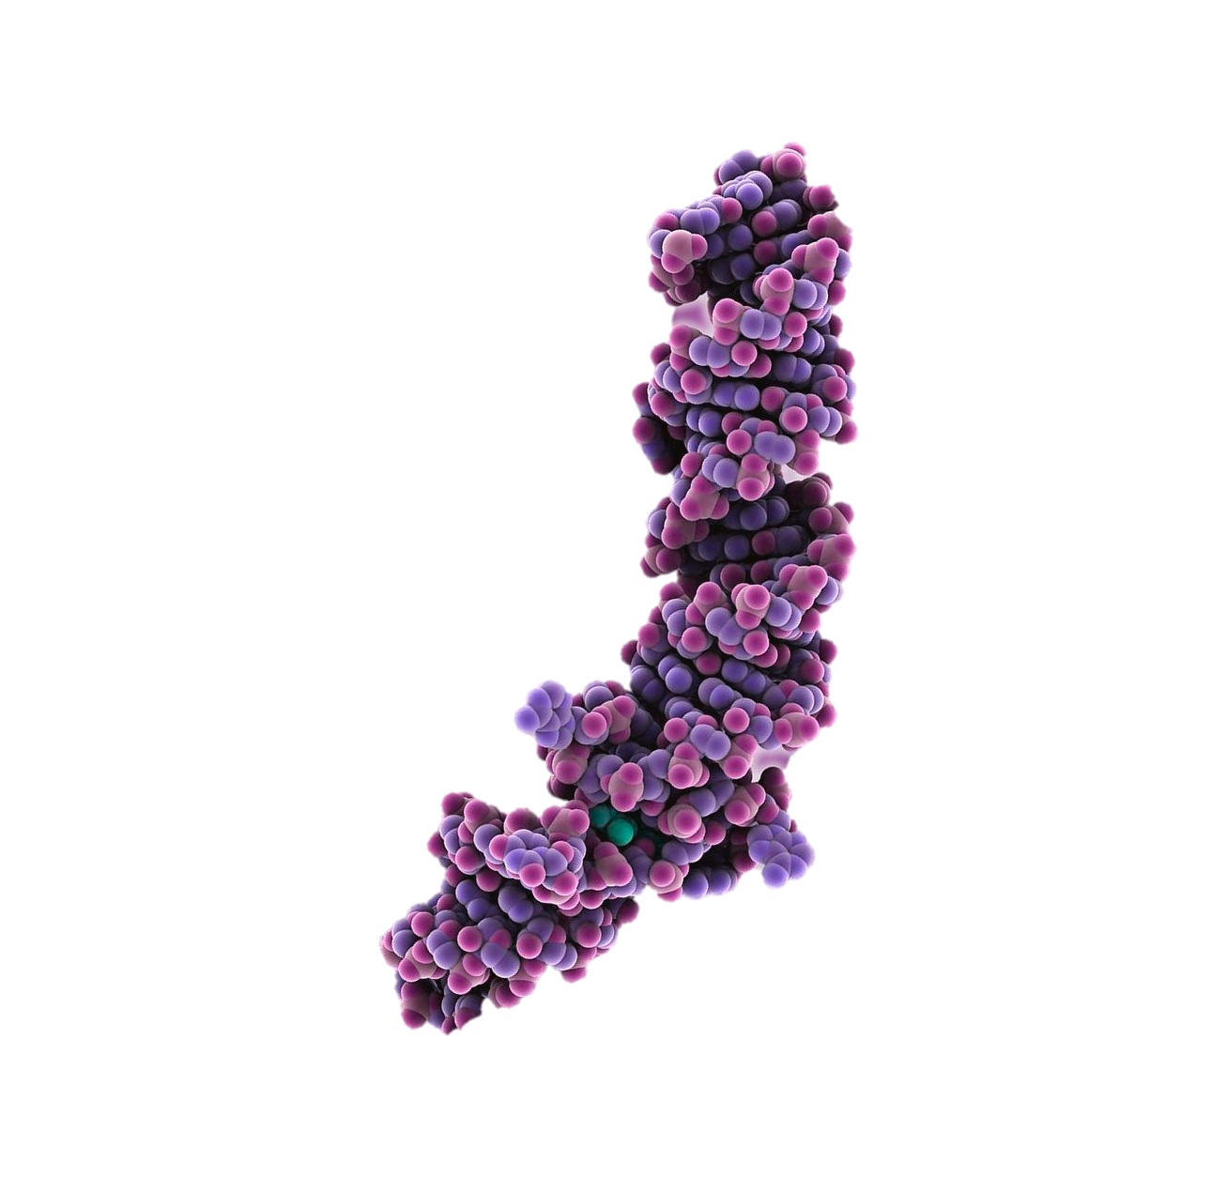
What Are Aptamers? How Can They Help?
ap·ta·mer, noun
Synthetic single-stranded DNA- or RNA-type molecules that are built from the same building blocks of human DNA or RNA. They can selectively bind to a target with high affinity and specificity.
1
Selection
Aptamers are single-stranded artificial DNA sequences selected in a lab to fit perfectly ​with a target molecule.
2
Binding
They stick tightly to their specific target, like a puzzle piece fitting into place.
3
Manufacturing
Aptamers are made in labs, allowing large-scale, cost-effective and high-quality production.​

Slide 6
Current uses of Aptamers
In 2004, Macugen was the first aptamer-based therapeutic approved by the FDA. The therapy targeted VEGF to prevent macular degeneration. Currently, there are over 11 aptamer-based therapeutics in clinical trials.
Aptamers in Cancer Diagnosis
Aptamers offer high sensitivity in early cancer diagnosis, have versatile applications in imaging, and display promise in targeted drug delivery, making them a compelling investment for advancing cancer therapies.
Aptamers in Infectious Disease Diagnosis
Aptamers offer the potential for rapid and accurate diagnosis of a wide range of infectious agents, from bacteria (e.g., E. coli) and viruses (e.g., COVID-19).
Aptamer for Geographic Atrophy
In August 2023, Iveric Bio received FDA approval for IZERVAY™ (Avacincaptad Pegol Intravitreal Solution), a new treatment for geographic atrophy
First Landmark Transaction
In July 2023, Astellas completed the acquisition of Iveric Bio for US$5.9B
https://www.ncbi.nlm.nih.gov/pmc/articles/PMC7407196/#:~:text=Many%20of%20the%20aptamers%20in,protein%E2%80%93receptor%E2%80%93ligand%20interaction, 2020

Slide 7

Potential Advantages of Aptamer-Based Therapies Over Antibody Treatments
Compared to monoclonal antibodies, aptamers have the potential to outperform across the board.
Speed to Market
Cost to Develop
Consistency
Aptamers are developed in significantly shorter time periods compared to antibodies.
Lab-synthesized aptamers do not utilize animal models or biologics, which are costly and often required for antibodies.
Aptamers are synthesized via digital sequence, improving on consistency, safety and quality.
Triera’s early Success
Initial indications
Growing the pipeline
Pre-clinical trials targeting COVID-19 demonstrate efficacy similar to monoclonal antibodies as a prophylaxis
Triera’s testing on initial indications demonstrates the ability to address many other categories of candidates as a platform technology
The Triera team is working on establishing a broad pipeline, including respiratory targets such as RSV, Influenza and Norovirus
Broad applicability

Slide 8
Historically, Aptamers have not been widely used due to several key challenges
CHALLENGE 1
Aptamers are often too small to stay in the body, leading to rapid renal clearance and insufficient bioavailability.
Size and Bioavailability
CHALLENGE 2
Allergic Reactions to PEG
Polyethylene glycol (PEG), while effective in increasing molecular weight, can cause allergic reactions in a small percentage of the population and has contributed to the failure of at least one aptamer therapeutic
CHALLENGE 3
Enzymatic Degradation
Aptamers are susceptible to degradation by enzymes in the body, reducing their efficacy.
CHALLENGE 4
Specific Selection
Previous aptamer therapeutics have bound to one isoform of a particular target, resulting in a therapy that (can be more limited in clinical efficacy when multi-targets or variants emerge) without addressing the flexibility to target multiple or changing forms of a target
CHALLENGE 5
Patents
Aptamers in their original form have been protected by a rigorous patents, including the SELEX process. Expiration of the patents has opened the door to innovation

Slide 9
What if we could develop therapeutics faster, more economically, and more effectively to address today’s global health challenges using Aptamers?

Slide 10
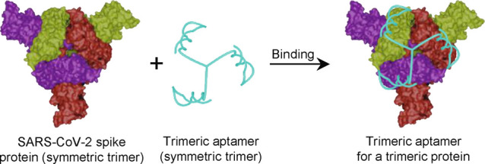
Trimeric Aptamer
Breakthrough technology that solves aptamer shortcomings and has demonstrated promising initial preclinical results with platform potential with Triera’s C19HBA (Covid-19 High Binding Aptamer)
C19HBA was developed originally for rapid detection platform as a therapy against SARS-CoV-2
C19HBA provided clinical and sterilizing protection against the Wuhan strain in a mice trials and matched the protection of S309 monoclonal antibody therapy
Provided prophylactically, C19HBA provides a minimum of 24 hours of clinical protection for mice exposed to a lethal challenge with the ability to extend the duration (testing ongoing)
Manufacturing yields are above 95%, demonstrating that this is a viable alternative to current antibody therapies
Patents submitted and pending
1
TMSA52
Three on Three: Universal and High-Affinity Molecular Recognition of the Symmetric Homotrimeric Spike Protein of SARS-CoV-2 with a Symmetric Homotrimeric Aptamer, 2023. Accessed December 11, 2023. https://pubs.acs.org/doi/full/10.1021/jacs.2c09870

Slide 11
Prophylactic potential
A prophylaxis serves as a proactive and targeted therapy to minimize the impact of infectious diseases, through prevention of transmission, prevention of infection, and protection for at-risk individuals, at a speed and in a manner that vaccines and other therapies cannot. Our current testing and application of aptamers is in a prophylactic treatment of SARS–CoV–2.
Our current testing and application of aptamers is in a prophylactic treatment of SARS–CoV–2.
Why this matters
Dosage for prophylaxis will regulate the exposure to the live virus towards a level the immune system can handle. This allows the immune system to engage and mitigating risk of reliance on a therapy
Most vulnerable people (immunocompromised and elderly/seniors) do not often respond well to vaccines and will benefit from the protection offered by a prophylactic, especially in high-risk settings such as care homes
Current vaccine data in the United states shows ~40% of Adults intent on not vaccinating, and only 7% up to date as of mid October. (CDC, 2023)
COVID and influenza vaccinations have a limited effectiveness, which changes by variant

Slide 12
Summary of testing completed to date
Within a short duration of time, R&D and testing done by Dr. Yingfu Li alongside Dr. Matthew Miller at McMaster University validated that C19HBA (Covid-19 High Binding Affinity) Aptamer works as effectively as the best SARS-CoV-2 antibody treatments in the market.
Study | Purpose | Result
In vitro neutralization against SARS-CoV-2 variants | Compare neutralizing potential of C19HBA vs. S309 against ancestral, BA5 and XBB 1.5 variants | S309 superior for ancestral variant while TMSA52 superior against more recent variants at similar concentrations
In vitro neutralization of C19HBA and C19HBA+ against ancestral variant | Assess the in vitro neutralization at same molarity of C19HBA and C19HBA+ to determine whether to test C19HBA+ in animals | C19HBA had 2X improved neutralization compared to base aptamer C19HBA+ had >2X improved neutralization than C19HBA suggesting further improvement for future in vivo testing
Ancestral in vivo test Moderate (10^4) and lethal (10^5) | Compare protection of C19HBA and S309 | C19HBA matched the performance of S309 clinical performance, provided complete protection of lungs
Duration Study | Extend protection evaluation from 2 to 24 hours of C19HBA | 24-hour protection was identical to 2-hour protection
Dosing Study | Reduce prophylactic from original 258 uM to 25.8 uM and 5.2 uM | Ten-fold lower dose provided similar clinical protection as higher dose. Lowest provide no protection.
Breadth Study for XBB 1.5 | Compare protection of C19HBA and S309 against XBB 1.5 variant | C19HBA matched or exceeded the protection of S309 providing clinical protection, lung viral titers >30% lower for C19HBA treated mice than S309

Slide 13
Solving the previous challenges for aptamers has unlocked their potential.
CHALLENGE 1
Aptamers are often too small to stay in the body, leading to rapid renal clearance and insufficient bioavailability.
Our patent pending aptamer technology is designed to increase bioavailability and remain in the system, resulting in an aptamer that stays in place long enough to do its job.
Size and Bioavailability
CHALLENGE 2
Polyethylene glycol (PEG), while effective in increasing molecular weight, can cause allergic reactions in a small percentage of the population.
Our aptamer technology does not require PEG, eliminating the risk of these allergic reactions.
Allergic Reactions to PEG
CHALLENGE 3
Aptamers are susceptible to degradation by enzymes in the body, reducing their efficacy.
We can leverage recent advancements in aptamer research to overcome this challenge.
Enzymatic Degradation
CHALLENGE 4
Previous aptamer therapeutics have bound to one isoform of a particular target, resulting in a therapy without the flexibility to target multiple or changing forms of a target
Our technology selected a universal aptamer that bound to the conserved receptor binding domain of the SARS-CoV-2 spike protein, extending the effectiveness of C19HBA against all known variants.
Specific Selection
CHALLENGE 5
Our patent builds on the original research, but with a different form. This allows new patents and ability to overcome previous challenges. We have a growing portfolio of provisional patents that protect the discoveries we have made that overcome the previous challenges of aptamers and unlock their potential.
Aptamers in their original form have been protected by a rigorous patents, including the SELEX process. Expiration of the patents has opened the door to innovation
Patents

Slide 14
Discovery Pipeline
Validation of current research and accelerated pre-clinical trials are the focus of initial planning and effort. Platform establishment and a long-term research and commercialization plan will be developed in conjunction with that research effort.
Target Selection
& Prioritization
Aptamer
Selection
Validation
(In-Vitro Testing)
Pre-Clinical
Testing
Clinical
Part 1
Clinical
Part 2
Clinical
Part 3
COVID-19
COMPLETED
PLANNED
Influenza
COMPLETED
PLANNED
Additional Targets
ITERATIVE & IN-PROGRESS

Slide 15

Triera & McMaster Partnership Advantage
Our aptamer platform is being developed under an exclusive worldwide 20-year license agreement between Dr Li’s lab at McMaster University and Triera.

Slide 16

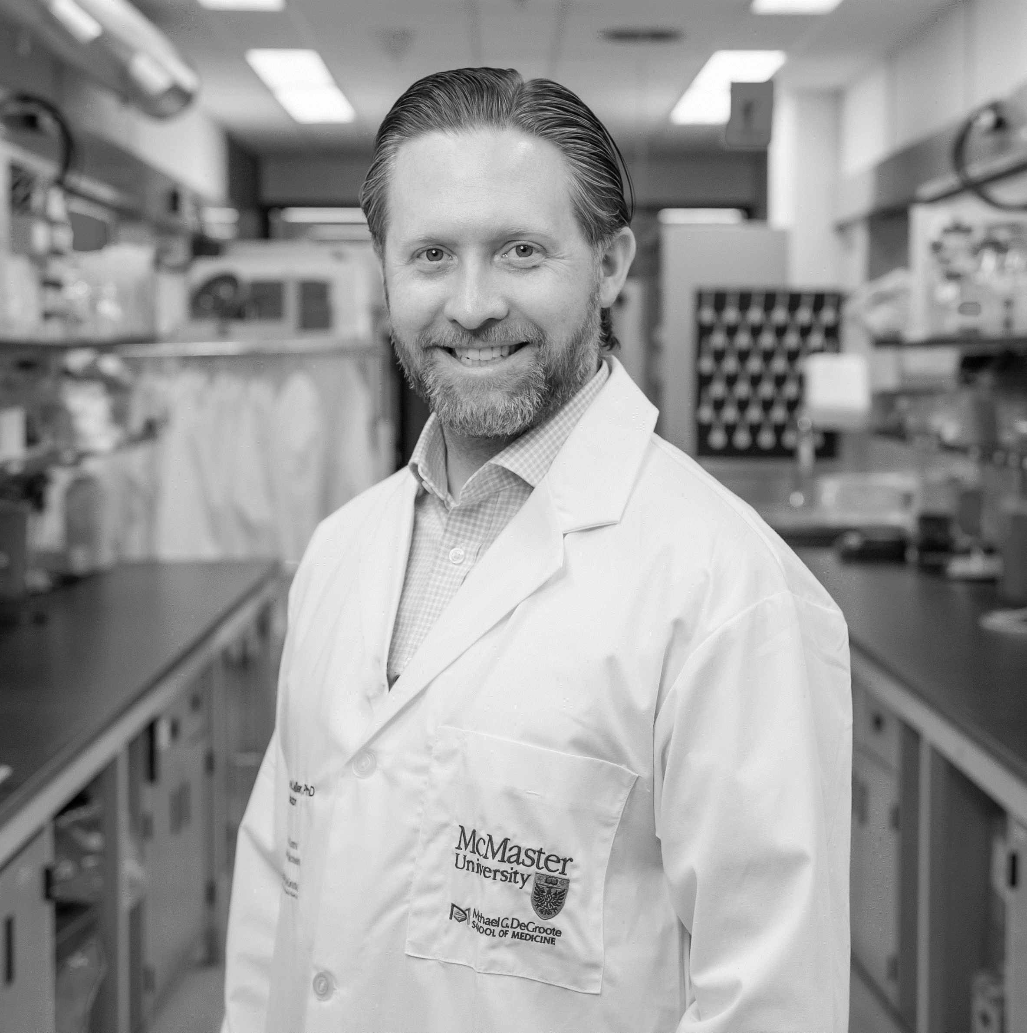


Leadership
McMaster University
Dr. Yingfu Li – Professor in the Department of Biochemisty and Biomedical Sciences
Earned a Ph.D. in Biochemistry from Simon Fraser University, and has earned many accolades in his career since: Governor General Academic Gold Medal, Engineering Research Council of Canada Doctoral Prize, and awarded postdoctoral fellow of the Medical Research Council of Canada. Following notable postdoctoral studies at Yale University, his research at McMaster has focused on aptamers and DNAzymes, where he has gained a global reputation as a leader in the field.
Dr. Matthew Miller – Associate Professor in the Department of Biochemistry and Biomedical Sciences
Completed his PhD at the University of Western Ontario studying the molecular virology of DNA viruses, and then conducted postdoctoral research at the Icahn School of Medicine focusing on characterizing the innate and adaptive immune responses to viral infection. His innovative and groundbreaking work has been instrumental in the ongoing development of a ‘universal’ influenza virus vaccine.
Triera Biosciences
Greg Fenton, CEO Zentek
Seasoned investment professional with a Bay Street career spanning nearly 30 years, including work in various capacities with ever-increasing responsibility in both the Canadian banking and investment management sectors. His experience spans many disciplines: capital markets, investment management, actuarial, pension, insurance, accounting, tax, and risk management.
Dr. Colin van der Kuur, CSO Zentek
Was the first graduate from University of Guelph with a Specialized Honours in Chemical Physics in 1993, and subsequently completed a doctorate in leadership in 2010. Through his leadership, Zentek is rapidly expanding a high-value IP portfolio through internal research, collaboration, and licensing world-leading technology.

Slide 17
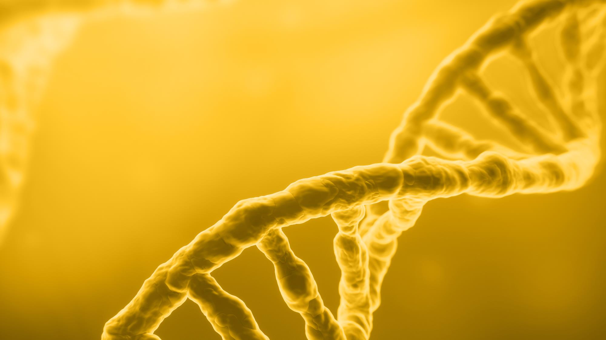
Thank you
For more information, contact:
gfenton@zentek.com
trierabiosciences.com

